Slide 1
Pertemuan 3
Decision Tree & Resampling Method

Slide 2
Administrative
Selamat datang di kelas Introduction to Machine Learning.
Kelas dimulai pukul 19:03 WIB.

Slide 3
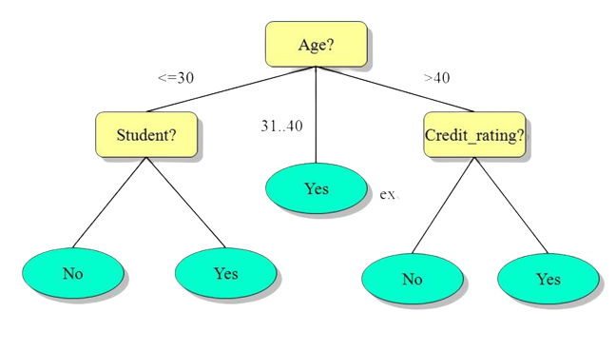


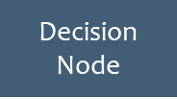

What is Decision Tree?
excellent
fair
no
yes
buys computer

Slide 4
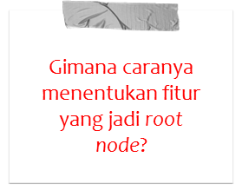

What is Decision Tree?

Slide 5
Introducing Information Gain!
Pengukuran seberapa baik sebuah fitur mampu memisahkan data berdasarkan kelasnya.
Semakin tinggi nilai IG, maka fitur semakin berpeluang menjadi root node.
Fitur dengan nilai IG tertinggi disebut best splitting attribute.
Untuk menghitung IG, perlu mengukur impurity atau entropy

Slide 6
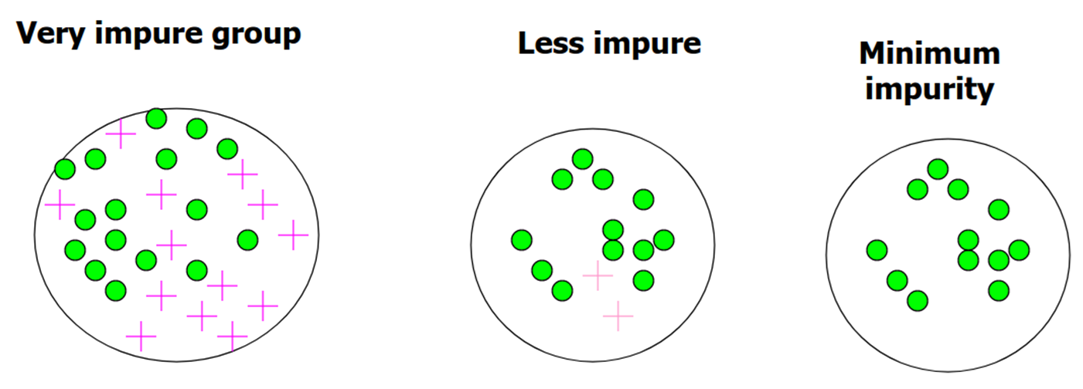
Introducing Information Gain!
Notes:
Range entropy: 0 … log2(num_class)

Slide 7
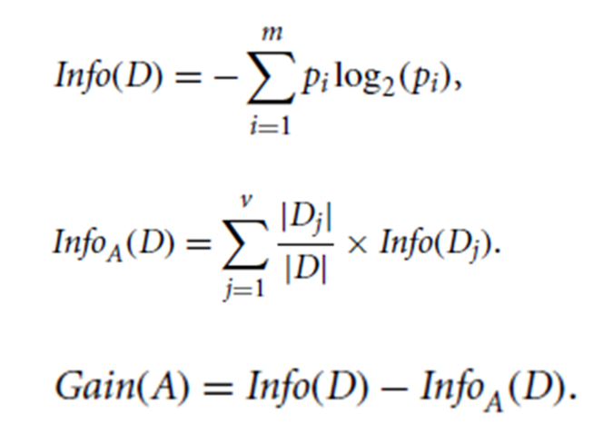
How to Calculate Info Gain?
Info(D) = entropy keseluruhan data
p_{i} = proporsi fitur dengan kelas i
m = jumlah kelas unik
Info_{A}(D) = entropy fitur A
|D_{j}| = jumlah fitur dengan nilai j
|D| = jumlah data
Gain(A) = IG atribut A

Slide 8
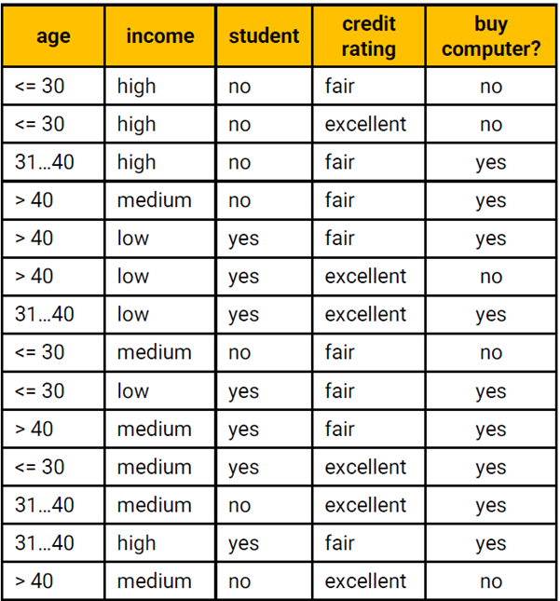
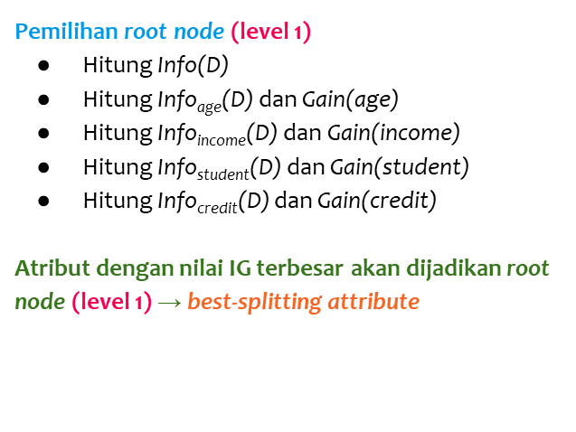
How to build a DT?

Slide 9
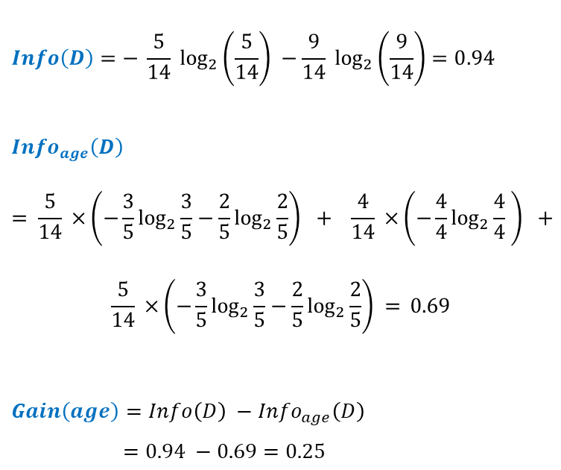
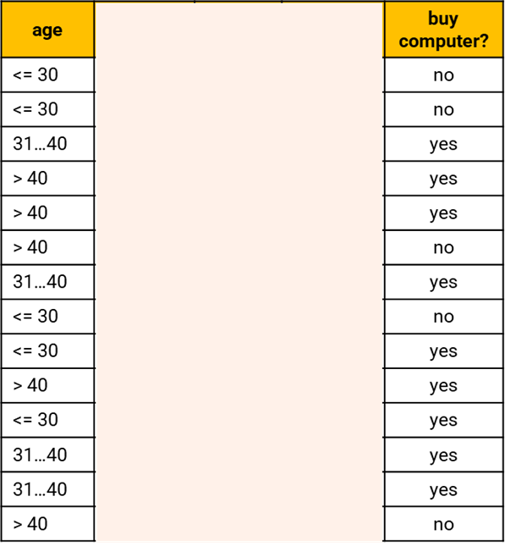
How to build a DT?

Slide 10
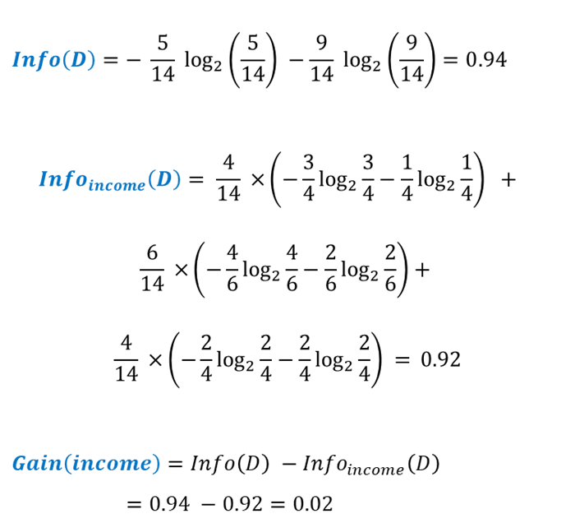
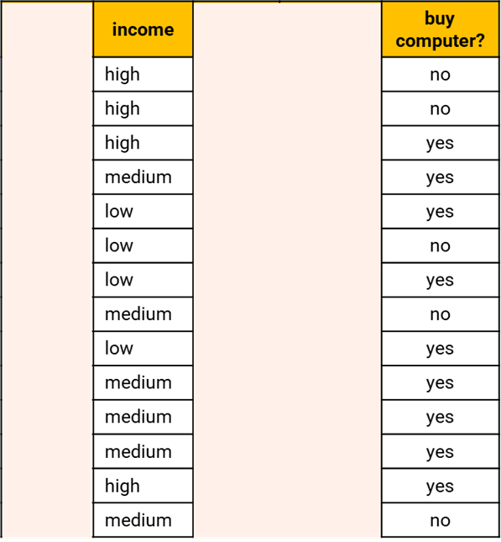
How to build a DT?

Slide 11
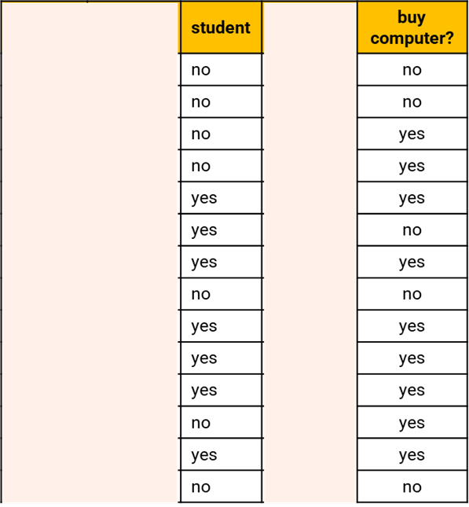
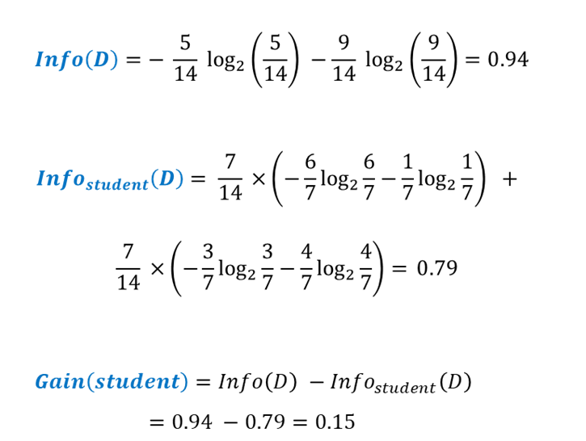
How to build a DT?

Slide 12
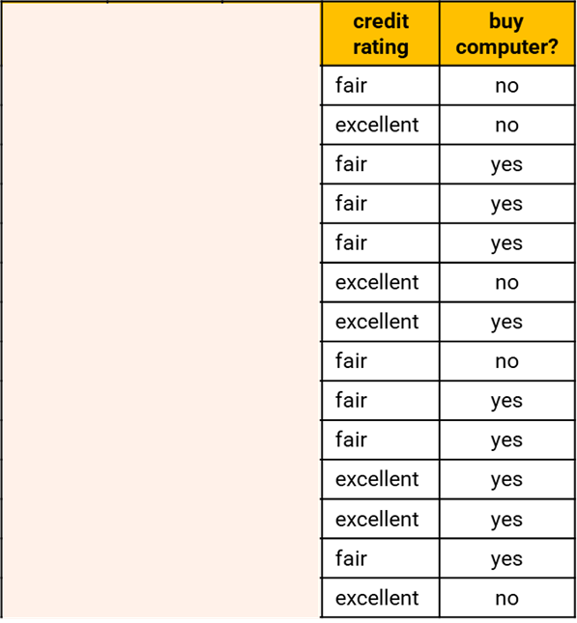
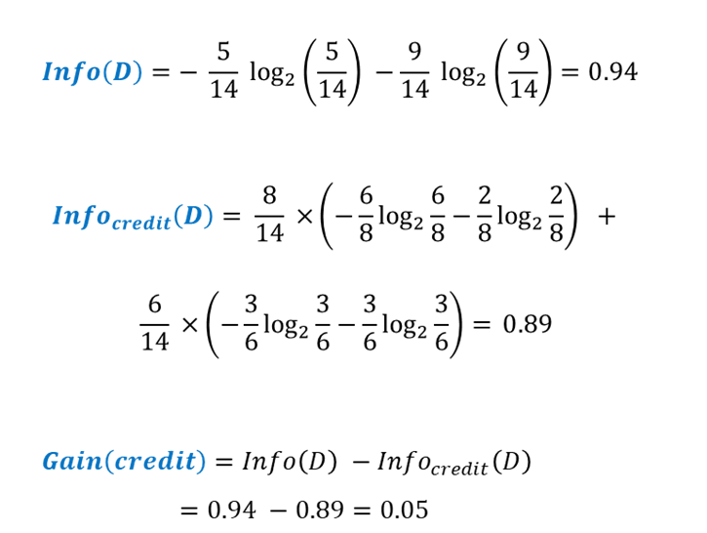
How to build a DT?

Slide 13

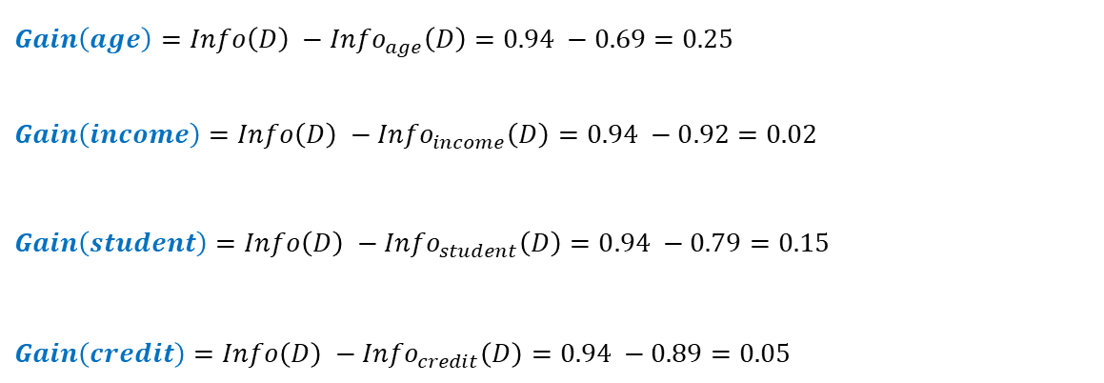
How to build a DT?

Slide 14
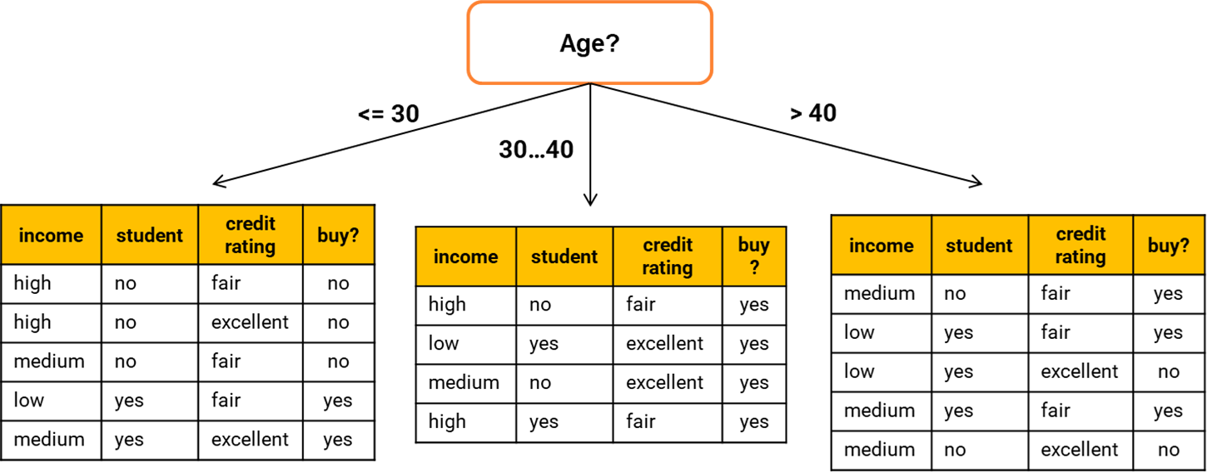
How to build a DT?

Slide 15
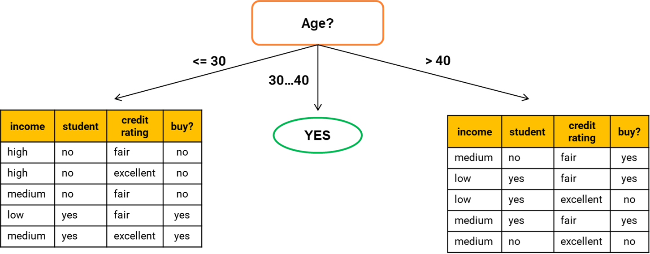
How to build a DT?

Slide 16
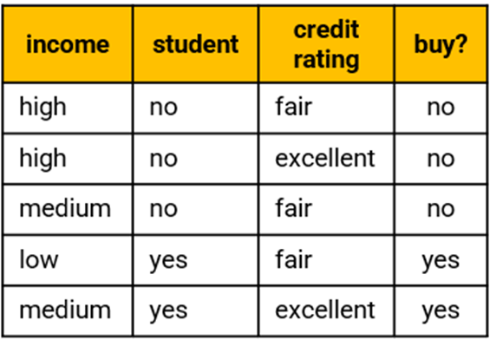
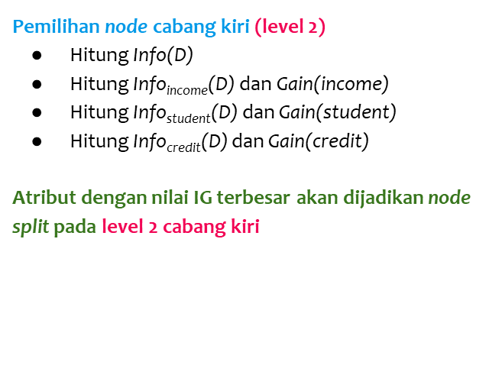
How to build a DT?

Slide 17
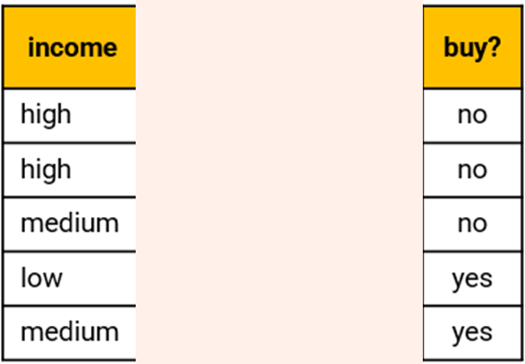
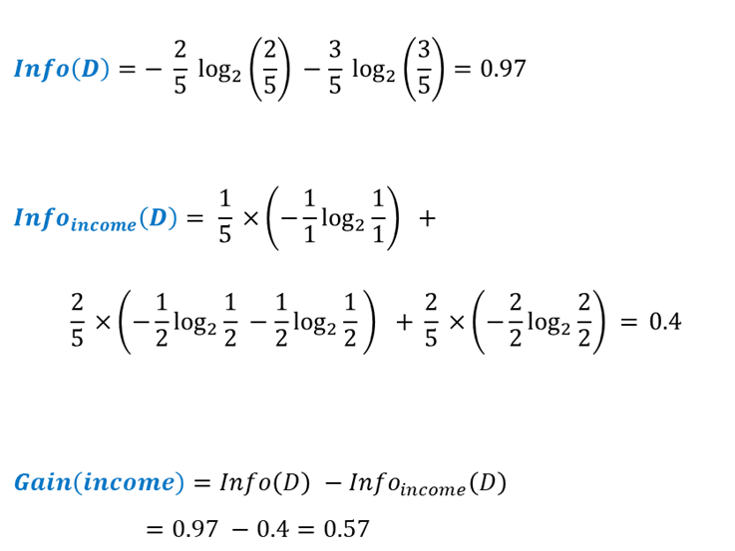
How to build a DT?

Slide 18
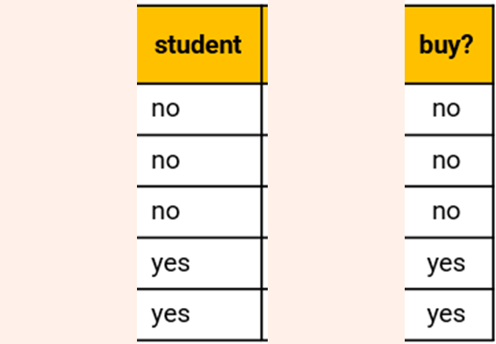
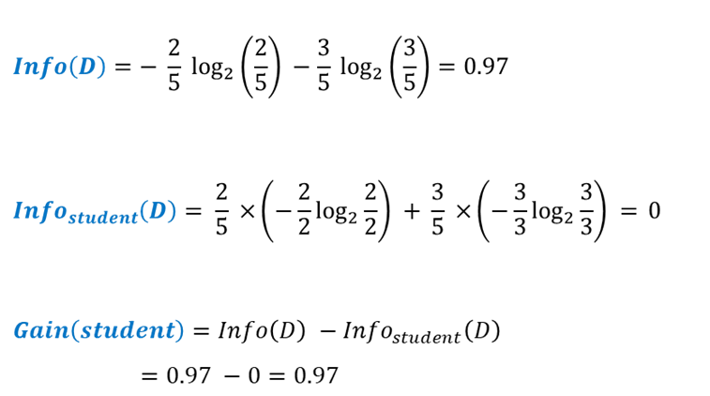
How to build a DT?

Slide 19
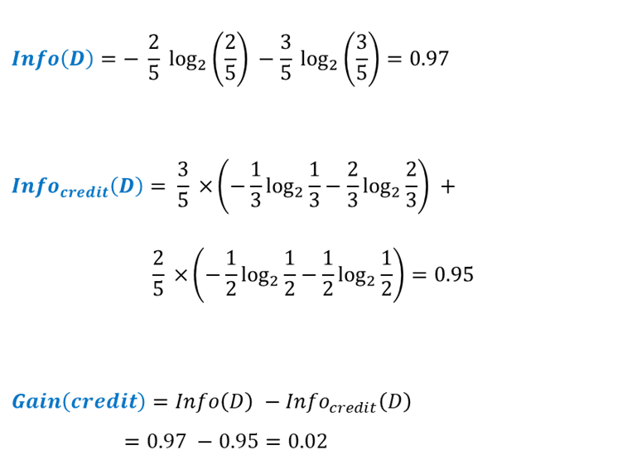

How to build a DT?

Slide 20
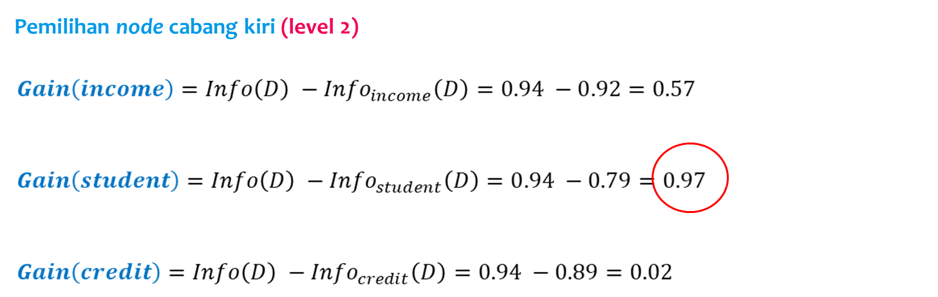
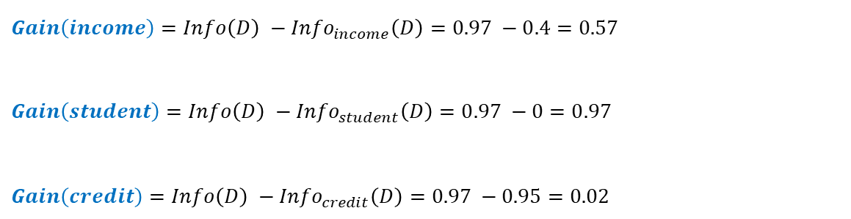
How to build a DT?

Slide 21
How to build a DT?

Slide 22
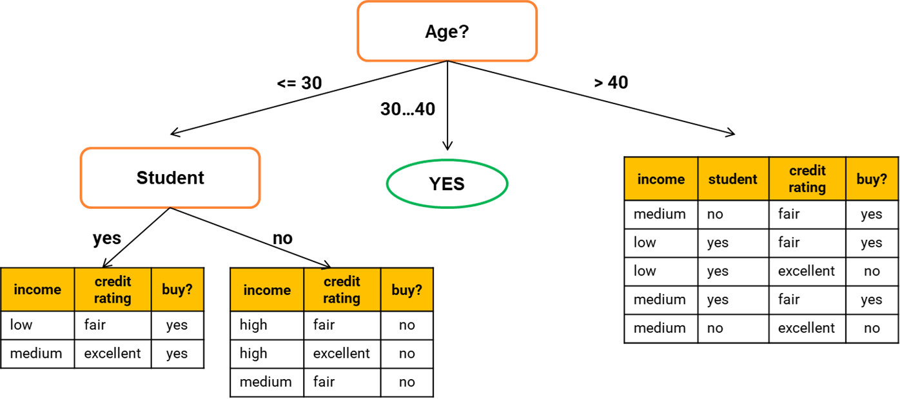
How to build a DT?

Slide 23
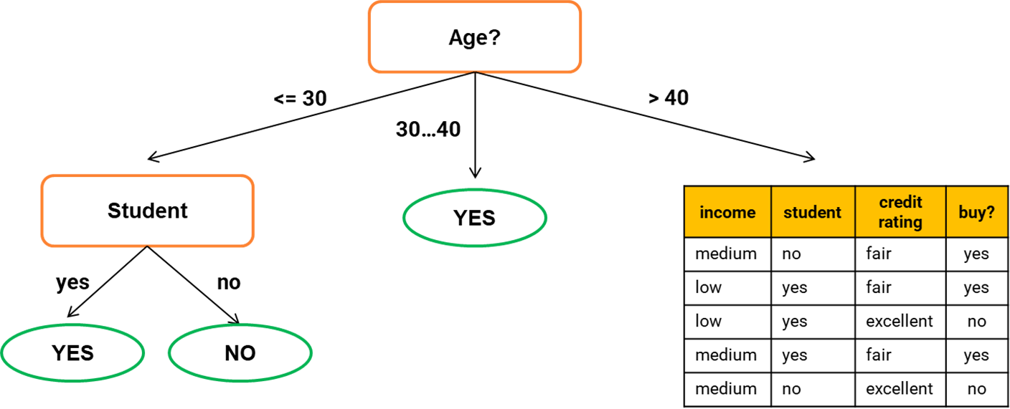
How to build a DT?

Slide 24
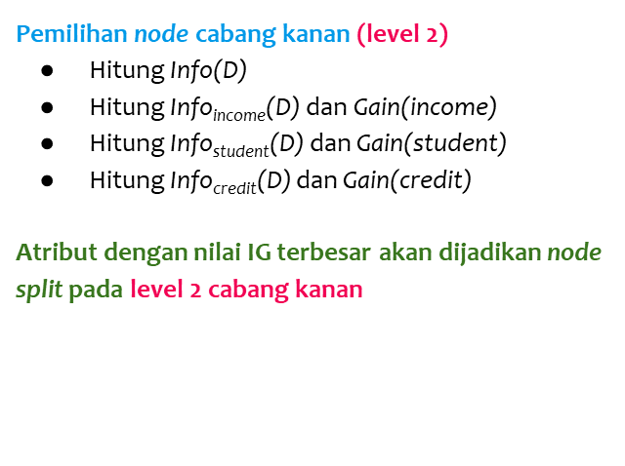
How to build a DT?

Slide 25
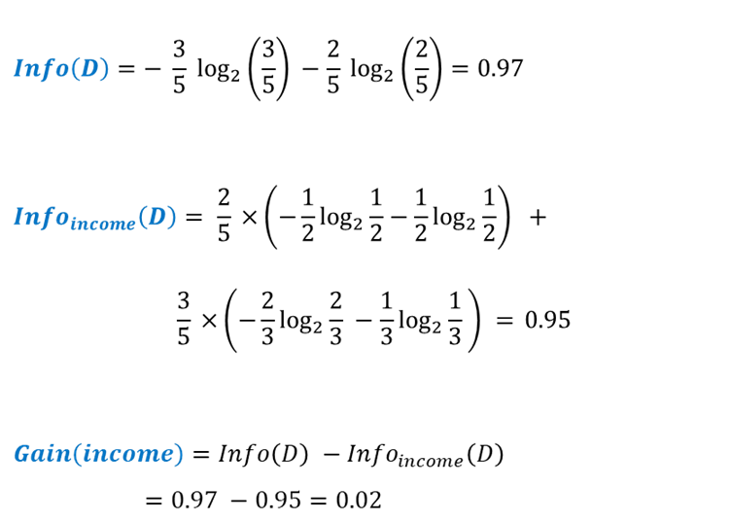
How to build a DT?

Slide 26
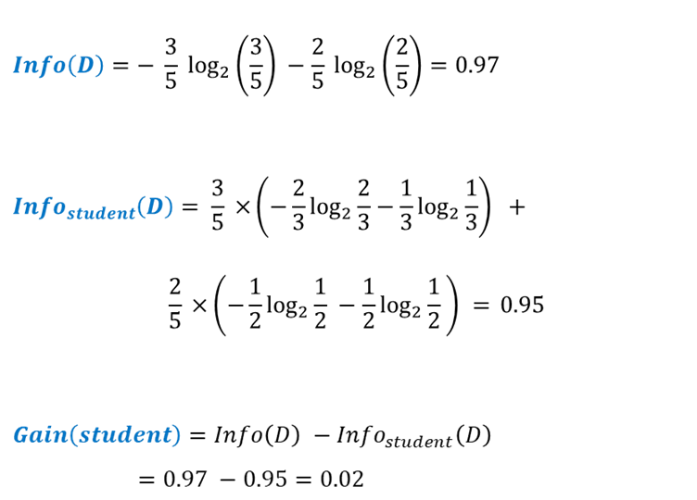
How to build a DT?

Slide 27
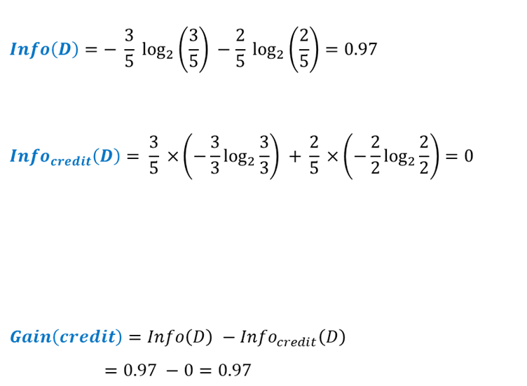
How to build a DT?

Slide 28
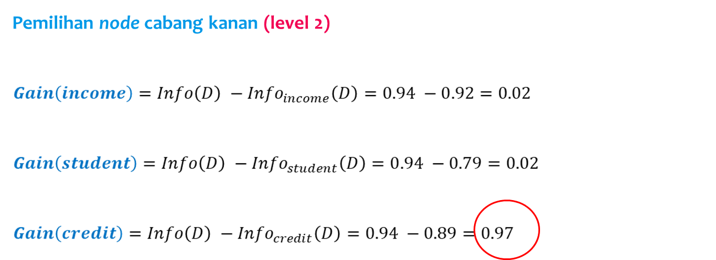
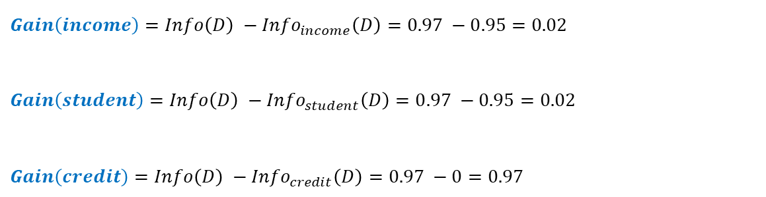
How to build a DT?

Slide 29
How to build a DT?

Slide 30
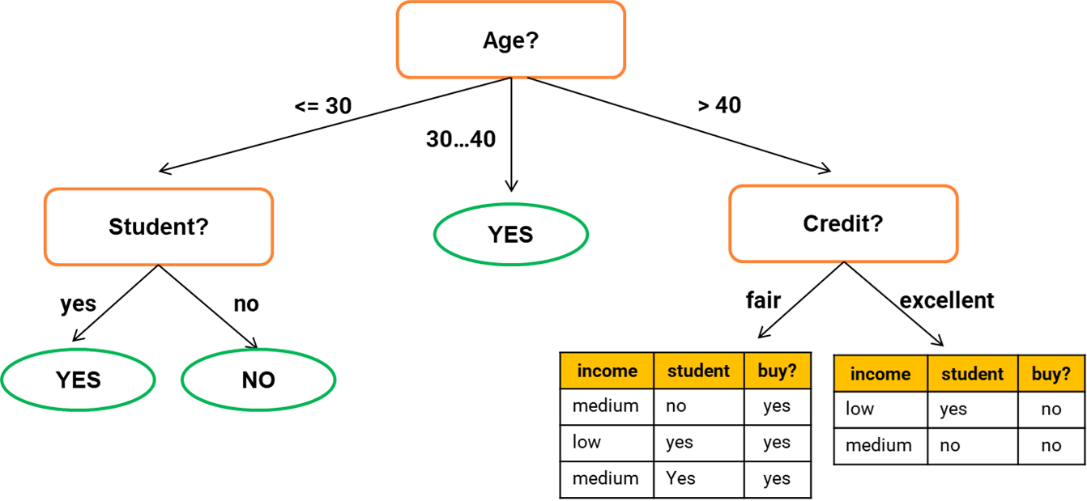
How to build a DT?

Slide 31
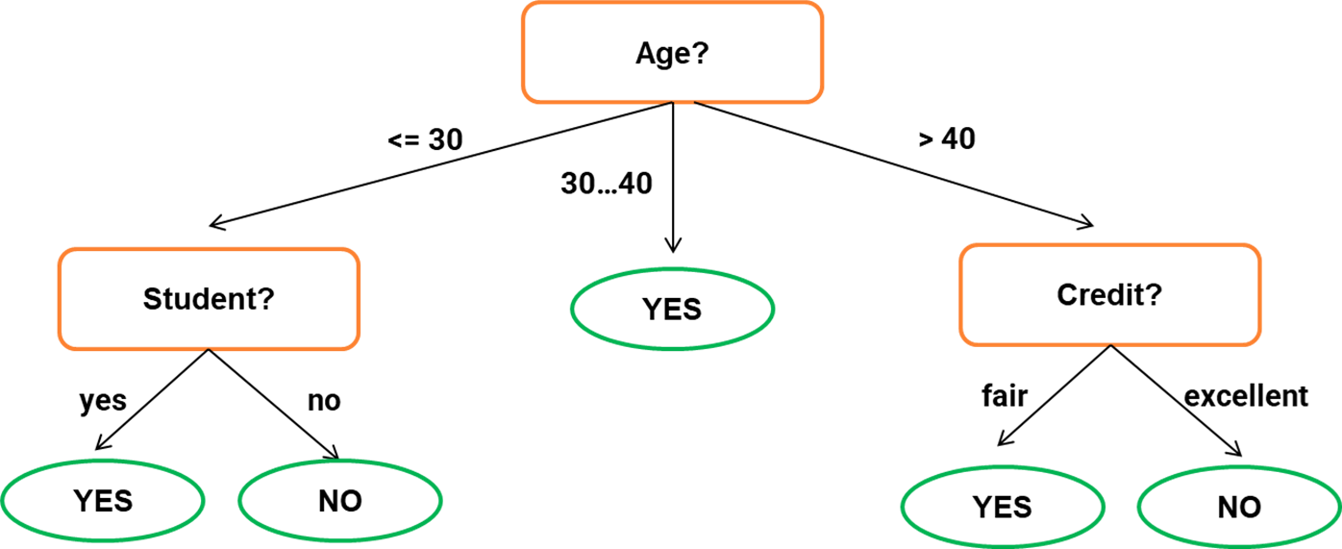
How to build a DT?

Slide 32
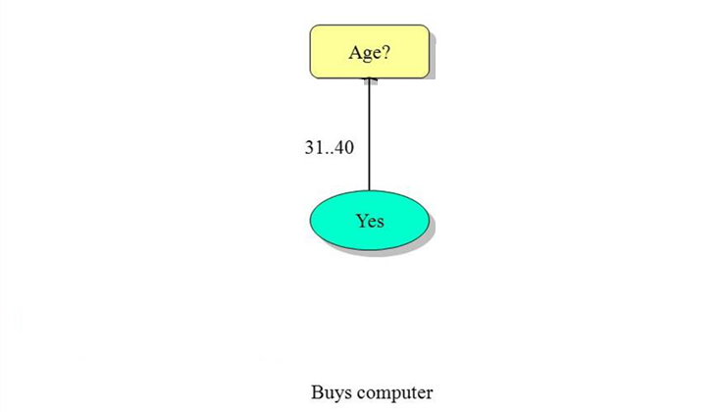
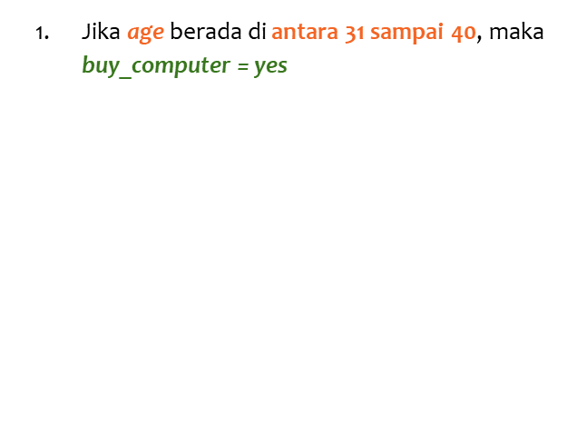
How to classify data in DT?

Slide 33
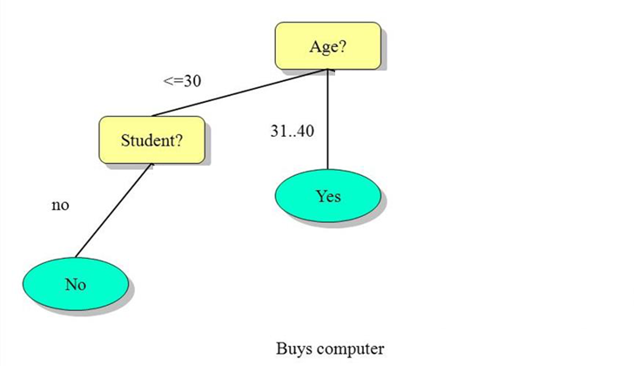
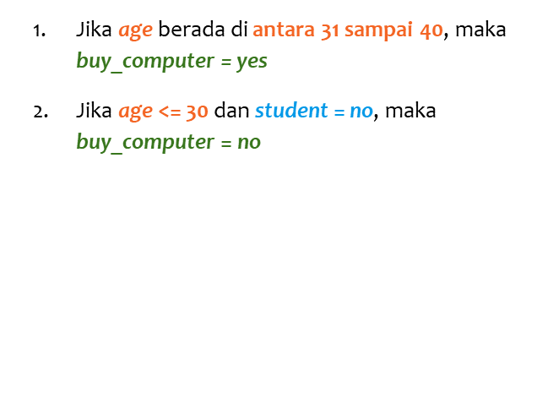
How to classify data in DT?

Slide 34
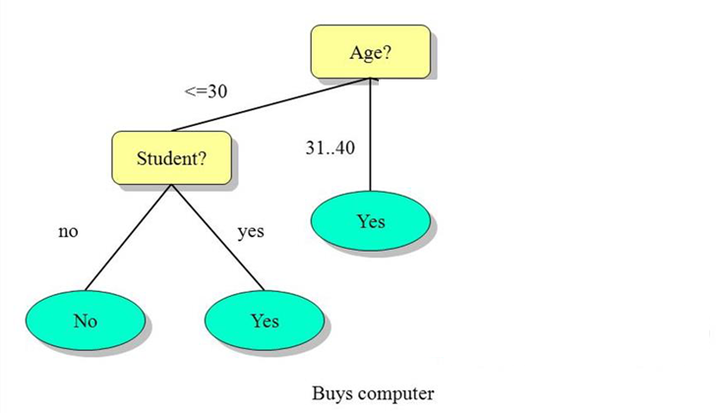
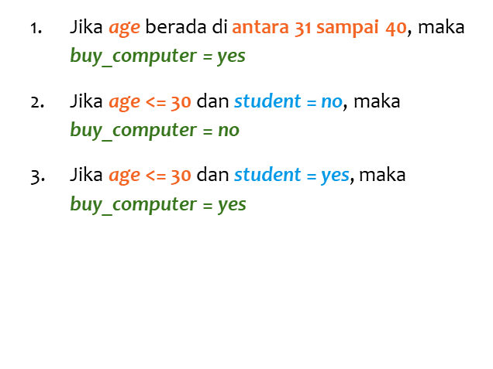
How to classify data in DT?

Slide 35
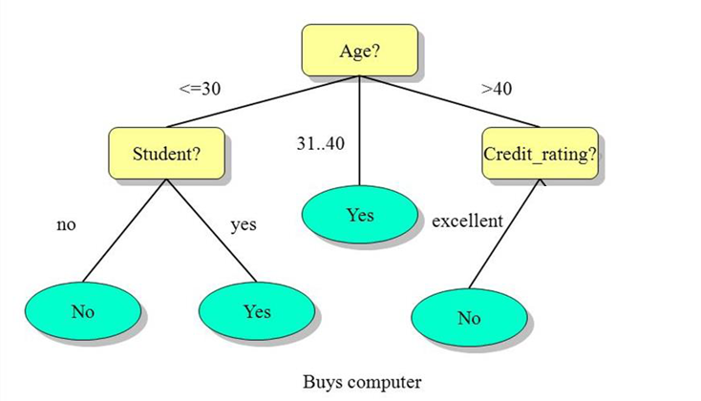
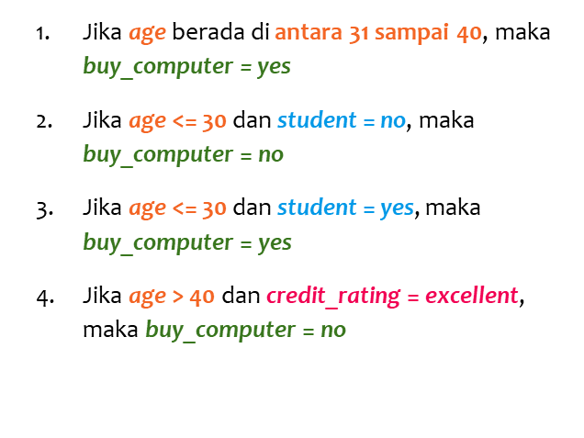
How to classify data in DT?

Slide 36
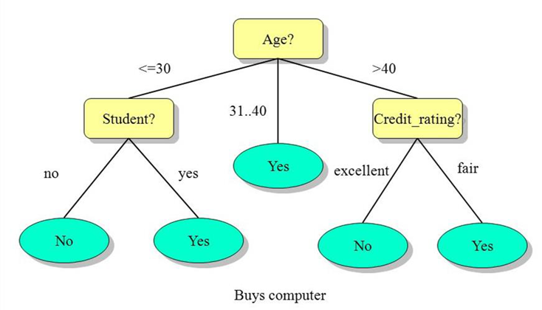
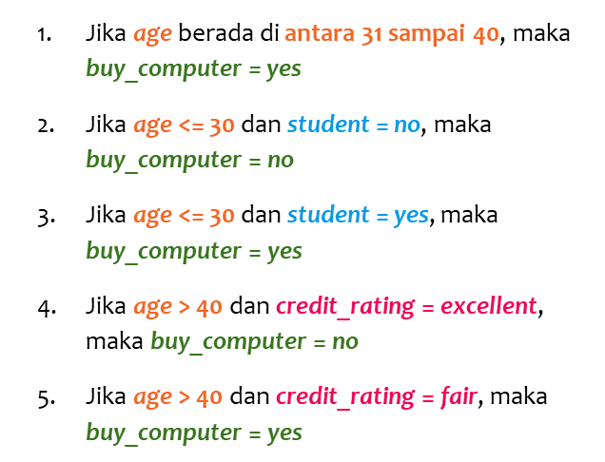
How to classify data in DT?

Slide 37
Hyperparameter in Decision Tree
max_depth, default=None
To avoid overfitting (tree pruning).
min_samples_leaf, default=1
Minimum number of samples required to be at a leaf node.
min_samples_split
Minimum number of samples required to split an internal node.
criterion
The function to measure the quality of a split.

Slide 38
Resampling Method

Slide 39
Resampling Method Recap
Mindmap

Slide 40
Confusion Matrix

Slide 41
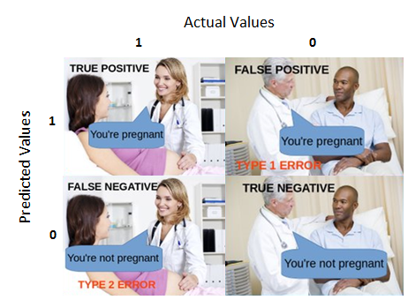
Confusion Matrix
True Positive
Diprediksi hamil dan memang benar hamil.

Slide 42
Confusion Matrix
True Positive
Diprediksi hamil dan memang benar hamil.
False Positive
Diprediksi hamil, namun sebenarnya tidak hamil

Slide 43
Confusion Matrix
True Positive
Diprediksi hamil dan memang benar hamil.
False Positive
Diprediksi hamil, namun sebenarnya tidak hamil
False Negative
Diprediksi tidak hamil namun sebenarnya hamil.

Slide 44
Confusion Matrix
True Positive
Diprediksi hamil dan memang benar hamil.
False Positive
Diprediksi hamil, namun sebenarnya tidak hamil
False Negative
Diprediksi tidak hamil namun sebenarnya hamil.
True Negative
Diprediksi tidak hamil dan memang benar tidak hamil.

Slide 45
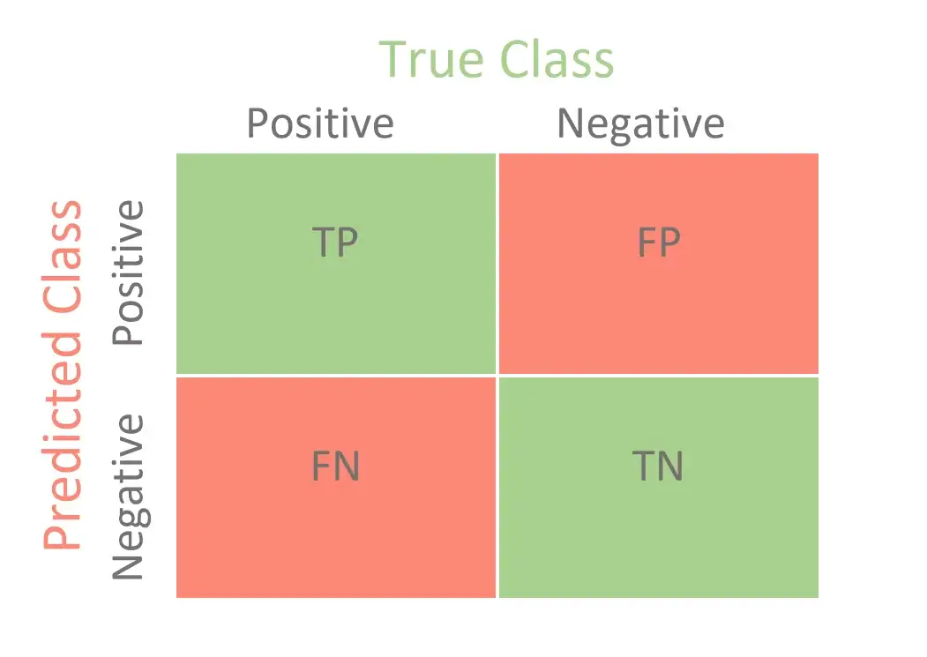
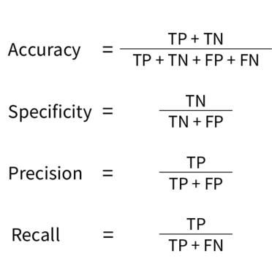

Confusion Matrix

Slide 46
Cross Validation & Hyperparameter Tuning

Slide 47

k-Fold Cross Validation
Model terbaik → CV score terbaik

Slide 48

Cross Validation + Hyperparameter Tuning
GridSearchCV RandomizedSearchCV

Slide 49
Cross Validation + Hyperparameter Tuning
GridSearchCV
Evaluates every possible combinations of hyperparameter values & get the best combination.
Good for relatively few combinations.
Guarantees finding the best combination.
RandomizedSearchCV
Evaluates a fixed number of combinations, selecting a random value for each hyperparameter at every iteration.
Does not guarantee finding the best combination, but generally more efficient in large spaces.
Notes:
Tips: Use random search first to identify promising regions, then apply grid search within those more focused ranges.

Slide 50
Poin Penting
Pahami cara membangun Decision Tree dan cara prediksinya pada kasus klasifikasi dan regresi.
Pahami konsep Information Gain untuk splitting attributes saat membangun DT.
Pahami cara evaluasi model regresi dan klasifikasi, serta intuisi berbagai metriknya.
Pahami konsep Confusion Matrix saat mengevaluasi model klasifikasi.
Pahami konsep Cross Validation untuk tuning model.

Slide 51
Form Feedback
Form Feedback Kelas
https://bit.ly/FeedbackKelasJuli2025

